Slide 1
Threads and Locking Mechanisms

Slide 2
Table of Contents
Thread
Types of Threads
Difference Between ULT and KLT
Relation Between ULT and KLT
Concurrency and Race Condition
Locking Mechanisms
References

Slide 3
Threads
A thread is the basic atomic unit of CPU utilization in computer systems. Mostly we consider a process to be the basic unit for CPU utilization, but a process may be further divided into multiple threads of execution. A process can be divided into different tasks or units that can execute independently, and these units are called threads.
A thread is a lightweight process that a scheduler can manage independently. It improves the application performance using parallelism. Thread shares information like data segment, code segment files, etc., with its peer threads while it contains its own registers, stack, counter, etc. The two main types of threads created in a computer system are:
1. User threads
2. Kernel threads
Threads can be created in the address space of the process itself, i.e., inside the process kernel involvement or without kernel involvement.

Slide 4
User level threads
User threads are the threads created by the user with the help of the user library.
User threads just stay in the address space of the creating process and are run and managed by the creating process without kernel involvement.
User-level threads are small and much faster than kernel-level threads. They are represented by a program counter (PC), stack, registers, and a small process control block.

Slide 5
Threads Management
As threads are they need to be managed by someone.
A thread is a sequence of instructions.
CPU can handle one instruction at a time.
To switch between instructions on parallel threads, the execution state needs to be saved.
Execution state in its simplest form is a program counter and CPU registers.
The program counter tells us what instruction to execute next.
CPU registers hold execution arguments, for example, addition operands.
This alternation between threads requires management.
Management includes saving state, restoring state, deciding what thread to pick next.

Slide 6
Kernel Threads
Kernel-level threads are handled by the operating system directly, and the kernel does thread management.
The kernel manages the context information for the process and the process threads.
Because of this, kernel-level threads are slower than user-level threads.
Advantages
Some of the advantages of kernel-level threads are as follows:
Multiple threads of the same process can be scheduled on different processors in kernel-level threads.
The kernel routines can also be multithreaded.
If a kernel-level thread is blocked, another thread of the same process can be scheduled by the kernel.

Slide 7
Kernel Threads
Disadvantages
Kernel level threads are also having the following disadvantages, such as:
A mode switch to kernel mode is required to transfer control from one thread to another in a process.
Kernel-level threads are slower to create as well as manage as compared to user-level threads.
Why must User Threads be mapped to Kernel Thread?
User threads need to be mapped to kernel threads because it's the kernel that schedules the thread for execution onto the CPU, and for that, it must know about the thread that it is scheduling.
All the user threads created by a process are executed over the same kernel-level thread appointed to the whole process. Whenever it's the turn for the specified process to execute on the CPU, its kernel thread is scheduled onto the CPU. All the other user threads inside the process have to be mapped one by one onto the kernel thread appointed to the creating process if they have to be executed.
Since all of them are controlled by the creating process itself, the user threads must be mapped onto the appointed kernel thread one by one and, therefore, executed.

Slide 8
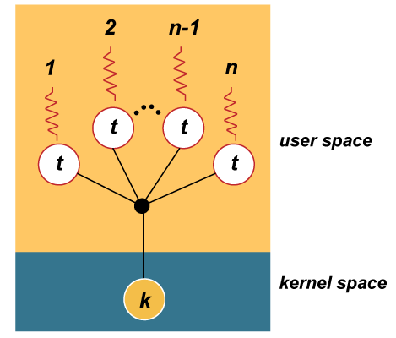
How User Thread mapped to Kernel Thread
User threads are mapped to kernel threads by the thread’s library. The way this mapping is done is called the “thread model”.
The mapping of user threads to kernel threads is done using “virtual processors”. A virtual processor (VP) is a library entity that is usually implicit. The VP is a kernel thread or a structure bound to a kernel thread in the library. For a user thread, the VP behaves like a CPU.
There are the following possible thread models, and all models are used to map user-level threads to kernel-level threads.
M:1 model: In the M:1 model, all user threads are mapped to one kernel thread. The process can only run one user-level thread at a time because there is only one kernel-level thread associated with the process. A library scheduler handles the mapping, and the library completely handles all user-threads programming facilities. This model can be used on any system, especially on traditional single-threaded systems.

Slide 9
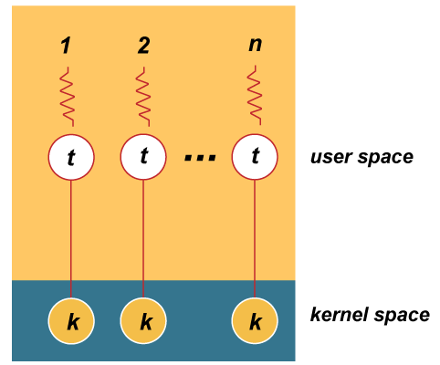
1:1 model: In the 1:1 model, each user thread is mapped to one kernel thread. Every user-level thread
executes on a separate kernel-level thread, or each user thread runs on one VP. Most of the user threads
programming facilities are directly handled by the kernel threads. This model is the default model

Slide 10
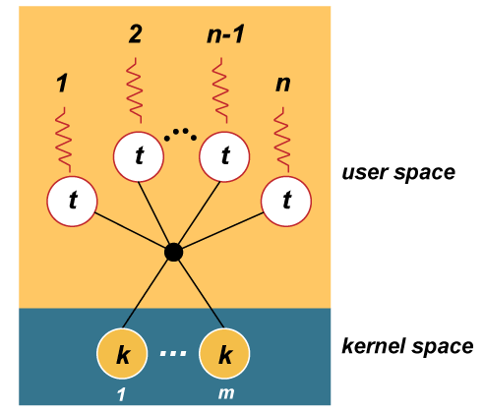
M: N model: In the M: N model, all user threads are mapped to a pool of kernel threads; all user threads run on a pool of virtual processors. The process is allocated m number of kernel-level threads to execute n number of user-level threads. A user thread may be bound to a specific VP, as in the 1:1 model. All unbound user threads share the remaining VPs.
In above models, there must be some way for the kernel to communicate with the user level thread manager to maintain an appropriate number of kernel threads allocated to the process. This mechanism is called scheduler activations.
The kernel provides the application with a set of kernel threads (virtual processors), and then the application has complete control over what threads to run on each of the kernel threads.

Slide 11
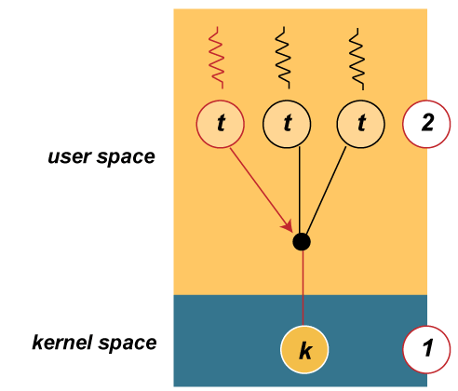
The kernel notifies the user-level thread manager of important kernel events using upcalls from the kernel to the user-level thread manager.
For example, let's study an example of how scheduler activations can be used.
The kernel has allocated one kernel thread to a process with three user-level threads.
The three user-level threads take turns executing on the single kernel-level thread.

Slide 12
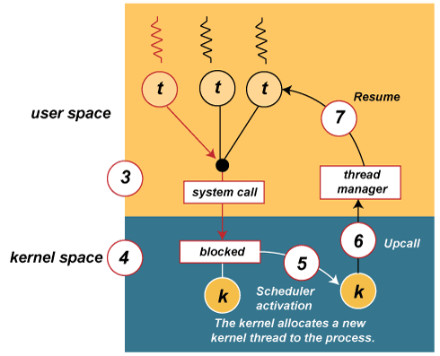
The executing thread makes a blocking system call.
The kernel blocks the calling user-level thread and the kernel-level thread used to execute the user-level thread
Scheduler activation: the kernel decides to allocate a new kernel-level thread to the process.
Upcall: the kernel notifies the user-level thread manager of which user-level thread is now blocked, and a new kernel-level thread is available.
The user-level thread manager moves the other threads to the new kernel thread and resumes one of the ready threads.

Slide 13
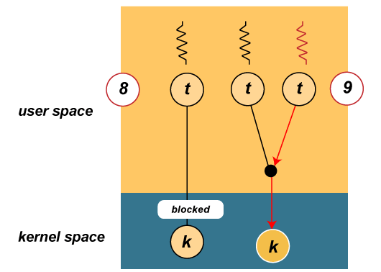
While one user-level thread is blocked,
The other threads can take turns executing on the new kernel thread

Slide 14
What Is Multithreading?
Multithreading is a form of parallelization or dividing up work for simultaneous processing. Instead of giving a large workload to a single core, threaded programs split the work into multiple software threads. These threads are processed in parallel by different CPU cores to save time.
Depending on how they’re built, games may be lightly threaded or heavily threaded. Some older game engines are known for their reliance on single-threaded performance, meaning they mostly use a single CPU core and get a major boost from higher clock speeds.
What Is Hyper-Threading?
Intel® Hyper-Threading Technology is a hardware innovation that allows more than one thread to run on each core. More threads mean more work can be done in parallel.
What Benefits Will I See from Hyper-Threading?
With CPU Hyper-Threading, a PC can process more information in less time and run more background tasks without disruption. Under the right circumstances, the technology lets CPU cores effectively do two things at once.

Slide 15
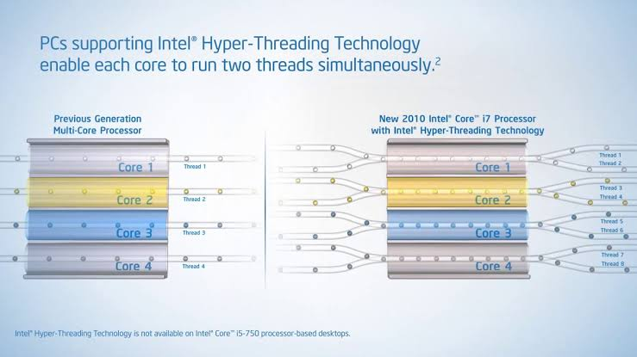
Multi-Threading and Hyper Threading Technology

Slide 16
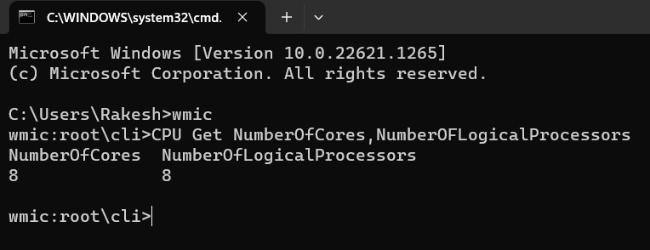
How to check whether our system is hyper-threaded or not?
For Windows:
1.Run command prompt
2.Use command “wmic”
3.Then run command“CPU Get NumberOfCores,NumberOFLogicalProcessors”
It will display the Number of cores and number of logical processors in your system
If the number of cores and logical processors equals, then your system is not hyper-threaded.
If the logical processors are twice the number of cores then the system is hyper-threaded.

Slide 17
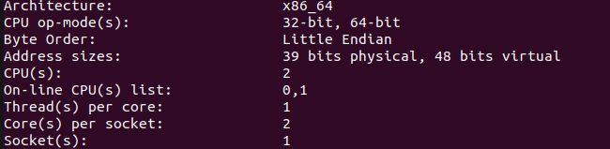
For Linux:
We have to use the below formula to know whether our system is hyper-threaded or not
The number of logicalcores is equal “Thread(s) per core” × “Core(s) per socket” × “Socket(s)”
and the number of physical cores on a machine equals “Core(s) per socket” × “Socket(s)”.
We can get required data by using the command “lscpu”.

Slide 18
Kernel Thread Management Functions:
There are many functions used in Kernel Thread. We will see each one by one. We can classify those functions based on functionalities.
Create Kernel Thread
Start kernel thread
Stop Kernel Thread
Other functions in Kernel Thread
To use the Kernel Thread-related functions we have to Mention the header file “linux/kthread.h”.
Creating Kernel Thread
By using the Below API we can create the kernel Thread.
struct task_struct* kthread_create (int(*threadfin(void *data),void *data, const char namefmt[], …);

Slide 19
Start kernel thread:
We have to use the function wake_up_process()
int wake_up_process (struct task_struct *p);
Where,
p is the struct task_struct type.
It returns 1 if the process was woken up, 0 if it was already running.
Stop Kernel Thread:
It stops a thread created by kthread_create
int kthread_stop ( struct task_struct *k);
Where,
k – thread created by kthread_create.
It Returns the result of threadfn, or –EINTR if wake_up_process was never called.

Slide 20
kthread_should_stop
int kthread_should_stop (void);
When someone calls kthread_stop on your kthread, it will be woken and this will return true. You should then return, and your return value will be passed through to kthread_stop.
kthread_bind
This is used to bind a just-created kthread to a CPU.
void kthread_bind (struct task_struct *k, unsigned int cpu);
Where, k – thread created by kthread_create.
cpu – CPU (might not be online, must be possible) for k to run on.
kthread_run
This is used to create and wake a thread.
kthread_run (threadfn, data, namefmt, ...);
Where, threadfn – the function to run until signal_pending(current).
data – data ptr for threadfn.
namefmt – printf-style name for the thread.
... – variable arguments

Slide 21
Race Condition
A race condition occurs when two or more threads can access shared data and they try to change it at the same time. Because the thread scheduling algorithm can swap between threads at any time, we don’t know the order in which the threads will attempt to access the shared data. Therefore, the result of the change in data is dependent on the thread scheduling algorithm, i.e. both threads are “racing” to access/change the data.
To avoid race conditions, we have many ways like Semaphore, Spinlock, and Mutex.
Mutex
A mutex is a mutual exclusion lock. Only one thread can hold the lock.
A mutex can be used to prevent the simultaneous execution of a block of code by multiple threads that are running in single or multiple processes.
Mutex is used as a synchronization primitive in situations where a resource has to be shared by multiple threads simultaneously.
A mutex has ownership. The thread which locks a Mutex must also unlock it.
So whenever you are accessing a shared resource that time first we lock the mutex and then access the shared resource. When we are finished with that shared resource then we unlock the Mutex.

Slide 22
Mutex in Linux Kernel
Today most major operating systems employ multitasking. Multitasking is where multiple threads can execute in parallel and thereby utilizing the CPU in an optimum way. Even though, multitasking is useful, if not implemented cautiously can lead to concurrency issues (Race condition), which can be very difficult to handle.
The actual mutex type (minus debugging fields) is quite simple:
struct mutex
{
atomic_t count;
spinlock_t wait_lock;
struct list_head wait_list;
};
We will be using this structure for Mutex in the Linux kernel. Refer to Linux/include/linux/mutex.h

Slide 23
Initializing Mutex
We can initialize Mutex in two ways
Static Method
Dynamic Method
Static Method
This method will be useful while using global Mutex. This macro is defined below.
DEFINE_MUTEX(name)
This call defines and initializes a mutex. Refer to Linux/include/linux/mutex.h
Dynamic Method
This method will be useful for per-object mutexes when the mutex is just a field in a heap-allocated object.
mutex_init(struct mutex *lock);
Mutex lock:
Once a mutex has been initialized, it can be locked by any one of them explained below.
mutex_lock
This is used to lock/acquire the mutex exclusively for the current task. If the mutex is not available, the current task will sleep until it acquires the Mutex

Slide 24
The mutex must, later on, be released by the same task that acquired it. Recursive locking is not allowed. The task may not exit without first unlocking the mutex. Also, kernel memory where the mutex resides must not be freed with the mutex still locked. The mutex must first be initialized (or statically defined) before it can be locked. memset-ing the mutex to 0 is not allowed.
void mutex_lock(struct mutex *lock);
mutex_lock_interruptible
Locks the mutex like mutex_lock, and returns 0 if the mutex has been acquired or sleeps until the mutex becomes available. If a signal arrives while waiting for the lock then this function returns -EINTR.
int mutex_lock_interruptible(struct mutex *lock);
mutex_trylock
This will try to acquire the mutex, without waiting (will attempt to obtain the lock, but will not sleep). Returns 1 if the mutex has been acquired successfully, and 0 on contention.
int mutex_trylock(struct mutex *lock);
This function must not be used in an interrupt context. The mutex must be released by the same task that acquired it.

Slide 25
Mutex Unlock
This is used to unlock/release a mutex that has been locked by a task previously.
This function must not be used in an interrupt context. Unlocking of a not locked mutex is not allowed.
void mutex_unlock(struct mutex *lock);
Mutex Status
This function is used to check whether mutex has been locked or not.
int mutex_is_locked(struct mutex *lock);
Returns 1 if the mutex is locked, 0 if unlocked.

Slide 26
Spin lock:
In Linux, a spinlock is a synchronization mechanism used to protect shared resources from concurrent access by multiple threads of execution, such as multiple processors or cores. A spinlock is a type of lock that does not put the thread to sleep when the lock is held by another thread. Instead, the thread repeatedly checks the lock's status in a loop (spinning) until the lock becomes available.
If the kernel is running on a uniprocessor and CONFIG_SMP, CONFIG_PREEMPT aren’t enabled while compiling the kernel then spinlock will not be available. Because there is no reason to have a lock when no one else can run at the same time.
We can initialize Spinlock in Linux kernel in two ways.
Static Method
Dynamic Method
Static Method:
You can statically initialize a Spinlock using the macro given below.
DEFINE_SPINLOCK(etx_spinlock);
Take a look at the expansion of DEFINE_SPINLOCK below.
#define DEFINE_SPINLOCK(x) spinlock_t x = __SPIN_LOCK_UNLOCKED(x)

Slide 27
Dynamic Method:
If you want to initialize dynamically you can use the method as given below.
spinlock_t etx_spinlock;
spin_lock_init(&etx_spinlock);
There are several approaches are there.
Lock Between user Context:
If you share data with user context (between Kernel Threads), then you can use this approach.
spin_lock(spinlock_t *lock)
This will take the lock if it is free, otherwise, it’ll spin until that lock is free (Keep trying).

Slide 28
Try Lock:
spin_trylock(spinlock_t *lock)
Locks the spinlock if it is not already locked. If unable to obtain the lock it exits with an error and does not spin. It returns non-zero if it obtains the lock otherwise returns zero.
Unlock:
spin_unlock(spinlock_t *lock)
It does the reverse of the lock. It will unlock which is locked by the above call.
Checking Lock:
spin_is_locked(spinlock_t *lock)
This is used to check whether the lock is available or not. It returns non-zero if the lock is currently acquired. otherwise returns zero.
We have similar type of functions for different approaches like:
void spin_lock_irqsave(spinlock_t *lock, unsigned long flags);
void spin_lock_irq(spinlock_t *lock);
void spin_lock_bh(spinlock_t *lock)

Slide 29
Read/write spinlock:
The kernel provides a reader/writer form of spinlocks that is directly analogous to the reader/writer semaphores we saw earlier in this chapter. These locks allow any number of readers into a critical section simultaneously, but writers must have exclusive access. Reader/writer locks have a type of rwlock_t, defined in . They can be declared and initialized in two ways:
Static way:
rwlock_t my_rwlock = RW_LOCK_UNLOCKED; /* Static way */
Dynamic Way:
rwlock_t my_rwlock;
rwlock_init(&my_rwlock); /* Dynamic way */
The list of functions available should lookreasonably familiar by now. For readers, the following functions are available:
void read_lock(rwlock_t *lock);
void read_lock_irqsave(rwlock_t *lock, unsigned long flags);
void read_lock_irq(rwlock_t *lock);
void read_lock_bh(rwlock_t *lock);

Slide 30
cont…
void read_unlock(rwlock_t *lock);
void read_unlock_irqrestore(rwlock_t *lock, unsigned long flags);
void read_unlock_irq(rwlock_t *lock);
void read_unlock_bh(rwlock_t *lock);
Similarly to the above-read functions we have to place write for write lock in read.

Slide 31
Semaphore…
A semaphore is a synchronization primitive that is commonly used in concurrent programming to control access to shared resources. It is essentially a variable that is used to signal between processes or threads to coordinate their activities.
Semaphores can be used to protect shared resources such as hardware devices or data structures, to prevent race conditions or deadlocks, and to implement synchronization between processes or threads.
In the Linux world, the “down” refers to the fact that the function decrements the value of the semaphore and, perhaps after putting the caller to sleep for a while to wait for the semaphore to become available, grants access to the protected resources. There are three versions of down:
void down(struct semaphore *sem);
int down_interruptible(struct semaphore *sem);
int down_trylock(struct semaphore *sem);

Slide 32
cont…
Once a thread has successfully called one of the versions of down, it is said to be “holding” the semaphore (or to have “taken out” or “acquired” the semaphore). That thread is now entitled to access the critical section protected by the semaphore. When the operations requiring mutual exclusion are complete, the semaphore must be returned. The Linux equivalent to V is up:
void up(struct semaphore *sem);
Once up has been called, the caller no longer holds the semaphore.
Reader/Writer Semaphores :
The Linux kernel provides a special type of semaphore called a rwsem (or “reader/writer semaphore”) for this situation. The use of rwsems in drivers is relatively rare, but they are occasionally useful.
Code using rwsems must include . The relevant data type for reader/writer semaphores is struct rw_semaphore; an rwsem must be explicitly initialized at runtime with:
void init_rwsem(struct rw_semaphore *sem);

Slide 33
The interface for code needing read-only access is:
void down_read(struct rw_semaphore *sem);
int down_read_trylock(struct rw_semaphore *sem);
void up_read(struct rw_semaphore *sem);
The interface for writers is similar:
void down_write(struct rw_semaphore *sem);
int down_write_trylock(struct rw_semaphore *sem);
void up_write(struct rw_semaphore *sem);
void downgrade_write(struct rw_semaphore *sem);

Slide 34
References
LDD3 text book
Os concepts by javatpoint and geeksforgeeks
Embetronicx WebSite

Slide 35
Thank you...

